Slide 1
Normalization
© Pearson Education Limited 1995, 2005

Slide 2
Purpose of Normalization
Normalization is a technique for producing a set of suitable relations that support the data requirements of an enterprise.
© Pearson Education Limited 1995, 2005

Slide 3
Purpose of Normalization
Characteristics of a suitable set of relations include:
  the minimal number of attributes necessary to support the data requirements of the enterprise;
  attributes with a close logical relationship are found in the same relation;
  minimal redundancy with each attribute represented only once with the important exception of attributes that form all or part of foreign keys.
© Pearson Education Limited 1995, 2005

Slide 4
Purpose of Normalization
The benefits of using a database that has a suitable set of relations is that the database will be:
  easier for the user to access and maintain the data;
  take up minimal storage space on the computer.
© Pearson Education Limited 1995, 2005

Slide 5
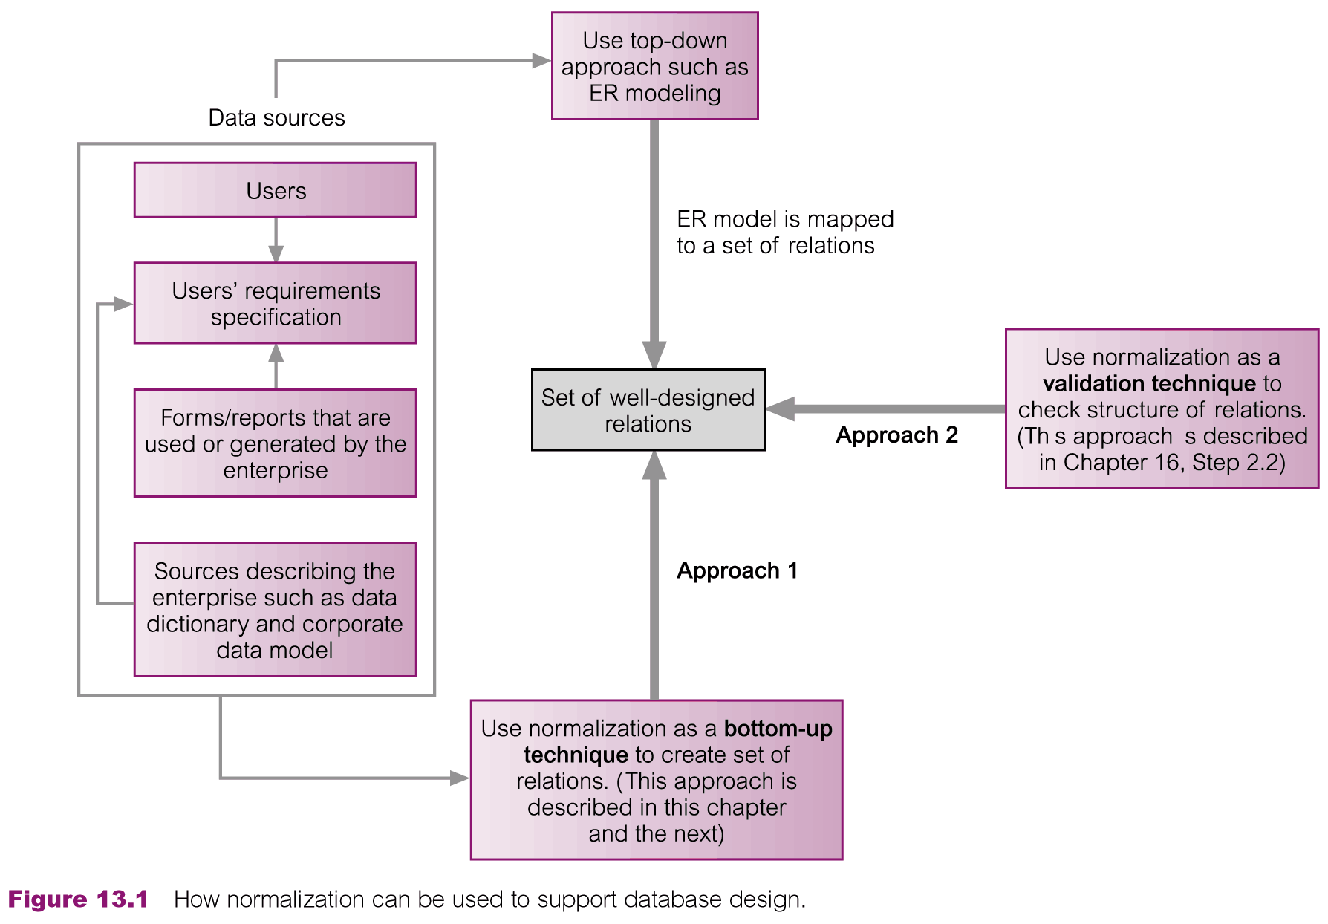
How Normalization Supports Database Design
© Pearson Education Limited 1995, 2005

Slide 6
Data Redundancy and Update Anomalies
Major aim of relational database design is to group attributes into relations to minimize data redundancy.
© Pearson Education Limited 1995, 2005

Slide 7
Data Redundancy and Update Anomalies
Potential benefits for implemented database include:
  Updates to the data stored in the database are achieved with a minimal number of operations thus reducing the opportunities for data inconsistencies.
  Reduction in the file storage space required by the base relations thus minimizing costs.
© Pearson Education Limited 1995, 2005

Slide 8
Data Redundancy and Update Anomalies
Problems associated with data redundancy are illustrated by comparing the Staff and Branch relations with the StaffBranch relation.
© Pearson Education Limited 1995, 2005

Slide 9


Data Redundancy and Update Anomalies
© Pearson Education Limited 1995, 2005

Slide 10
Data Redundancy and Update Anomalies
StaffBranch relation has redundant data; the details of a branch are repeated for every member of staff.
In contrast, the branch information appears only once for each branch in the Branch relation and only the branch number (branchNo) is repeated in the Staff relation, to represent where each member of staff is located.
© Pearson Education Limited 1995, 2005

Slide 11
Data Redundancy and Update Anomalies
Relations that contain redundant information may potentially suffer from update anomalies.
Types of update anomalies include
  Insertion
  Deletion
  Modification
© Pearson Education Limited 1995, 2005

Slide 12
Lossless-join and Dependency Preservation Properties
Two important properties of decomposition.
  Lossless-join property enables us to find any instance of the original relation from corresponding instances in the smaller relations.
  Dependency preservation property enables us to enforce a constraint on the original relation by enforcing some constraint on each of the smaller relations.
© Pearson Education Limited 1995, 2005

Slide 13
Functional Dependencies
Important concept associated with normalization.
Functional dependency describes relationship between attributes.
For example, if A and B are attributes of relation R, B is functionally dependent on A (denoted A → B), if each value of A in R is associated with exactly one value of B in R.
© Pearson Education Limited 1995, 2005

Slide 14
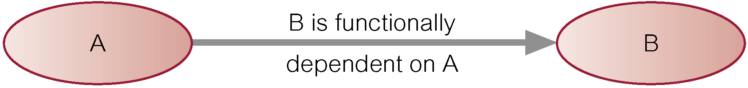
Characteristics of Functional Dependencies
Property of the meaning or semantics of the attributes in a relation.
Diagrammatic representation.
The determinant of a functional dependency refers to the attribute or group of attributes on the left-hand side of the arrow.
© Pearson Education Limited 1995, 2005

Slide 15
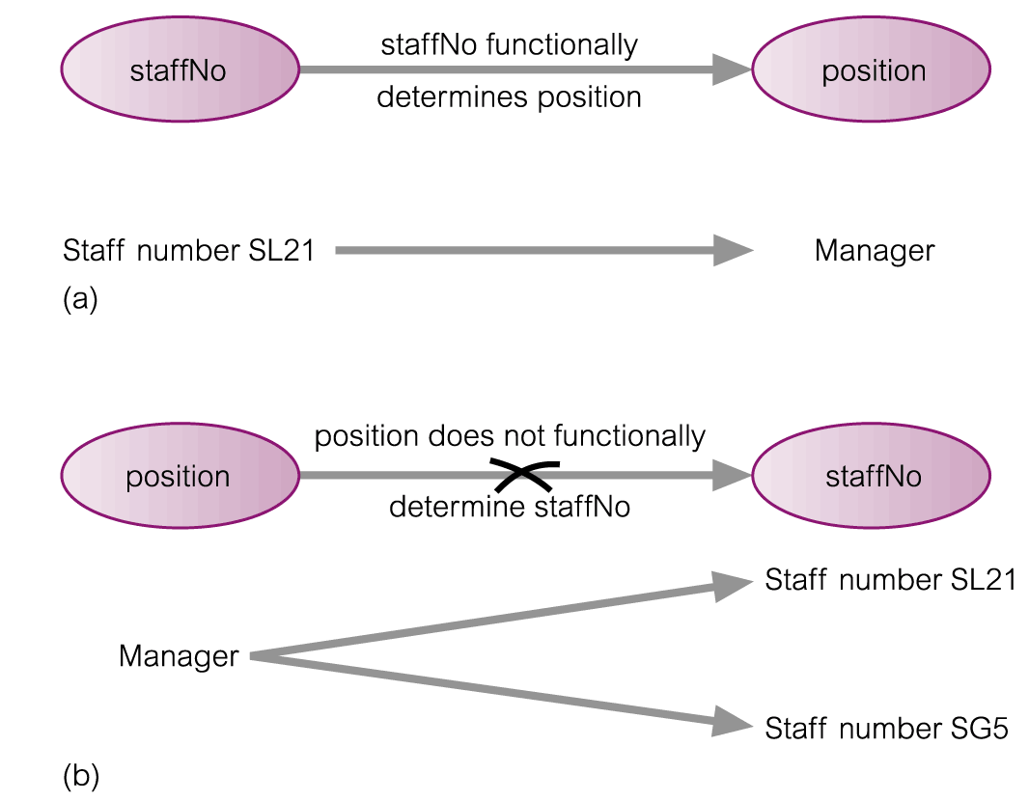
An Example Functional Dependency
© Pearson Education Limited 1995, 2005

Slide 16
Example Functional Dependency that holds for all Time
Consider the values shown in staffNo and sName attributes of the Staff relation (see Slide 12).
Based on sample data, the following functional dependencies appear to hold.
  staffNo → sName
  sName → staffNo
© Pearson Education Limited 1995, 2005

Slide 17
Example Functional Dependency that holds for all Time
However, the only functional dependency that remains true for all possible values for the staffNo and sName attributes of the Staff relation is:
  staffNo → sName
© Pearson Education Limited 1995, 2005

Slide 18
Characteristics of Functional Dependencies
Determinants should have the minimal number of attributes necessary to maintain the functional dependency with the attribute(s) on the right hand-side.
This requirement is called full functional dependency.
© Pearson Education Limited 1995, 2005

Slide 19
Characteristics of Functional Dependencies
Full functional dependency indicates that if A and B are attributes of a relation, B is fully functionally dependent on A, if B is functionally dependent on A, but not on any proper subset of A.
© Pearson Education Limited 1995, 2005

Slide 20
Example Full Functional Dependency
Exists in the Staff relation (see Slide 12).
staffNo, sName → branchNo
True - each value of (staffNo, sName) is associated with a single value of branchNo.
However, branchNo is also functionally dependent on a subset of (staffNo, sName), namely staffNo. Example above is a partial dependency.
© Pearson Education Limited 1995, 2005

Slide 21
Characteristics of Functional Dependencies
Main characteristics of functional dependencies used in normalization:
  There is a one-to-one relationship between the attribute(s) on the left-hand side (determinant) and those on the right-hand side of a functional dependency.
  Holds for all time.
  The determinant has the minimal number of attributes necessary to maintain the dependency with the attribute(s) on the right hand-side.
© Pearson Education Limited 1995, 2005

Slide 22
Transitive Dependencies
Important to recognize a transitive dependency because its existence in a relation can potentially cause update anomalies.
Transitive dependency describes a condition where A, B, and C are attributes of a relation such that if A → B and B → C, then C is transitively dependent on A via B (provided that A is not functionally dependent on B or C).
© Pearson Education Limited 1995, 2005

Slide 23
Example Transitive Dependency
Consider functional dependencies in the StaffBranch relation (see Slide 12).
staffNo → sName, position, salary, branchNo, bAddress
branchNo → bAddress
Transitive dependency, branchNo → bAddress exists on staffNo via branchNo.
© Pearson Education Limited 1995, 2005

Slide 24
The Process of Normalization
Formal technique for analyzing a relation based on its primary key and the functional dependencies between the attributes of that relation.
Often executed as a series of steps. Each step corresponds to a specific normal form, which has known properties.
© Pearson Education Limited 1995, 2005

Slide 25
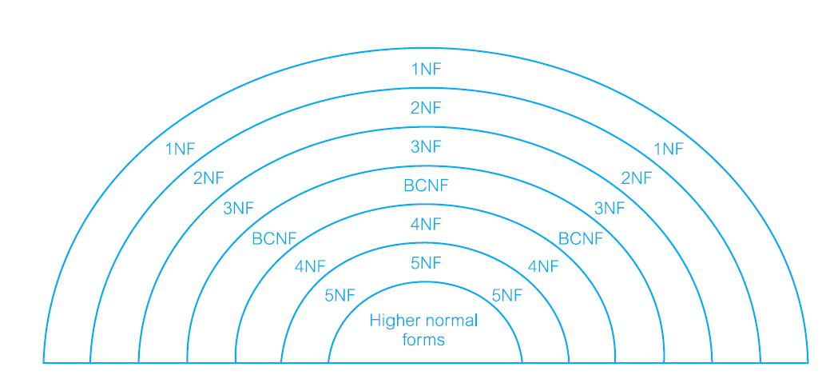

Slide 26
Identifying Functional Dependencies
Identifying all functional dependencies between a set of attributes is relatively simple if the meaning of each attribute and the relationships between the attributes are well understood.
This information should be provided by the enterprise in the form of discussions with users and/or documentation such as the users’ requirements specification.
© Pearson Education Limited 1995, 2005

Slide 27
Identifying Functional Dependencies
However, if the users are unavailable for consultation and/or the documentation is incomplete then depending on the database application it may be necessary for the database designer to use their common sense and/or experience to provide the missing information.
© Pearson Education Limited 1995, 2005

Slide 28
Data Redundancy and Update Anomalies
© Pearson Education Limited 1995, 2005

Slide 29
Example - Identifying a set of functional dependencies for the StaffBranch relation
Examine semantics of attributes in StaffBranch relation (see Slide 12). Assume that position held and branch determine a member of staff’s salary.
© Pearson Education Limited 1995, 2005

Slide 30
Example - Identifying a set of functional dependencies for the StaffBranch relation
With sufficient information available, identify the functional dependencies for the StaffBranch relation as:
staffNo → sName, position, salary, branchNo, bAddress
branchNo → bAddress
bAddress → branchNo
branchNo, position → salary
bAddress, position → salary
© Pearson Education Limited 1995, 2005

Slide 31
Example - Using sample data to identify functional dependencies.
Consider the data for attributes denoted A, B, C, D, and E in the Sample relation (see Slide 33).
Important to establish that sample data values shown in relation are representative of all possible values that can be held by attributes A, B, C, D, and E. Assume true despite the relatively small amount of data shown in this relation.
© Pearson Education Limited 1995, 2005

Slide 32
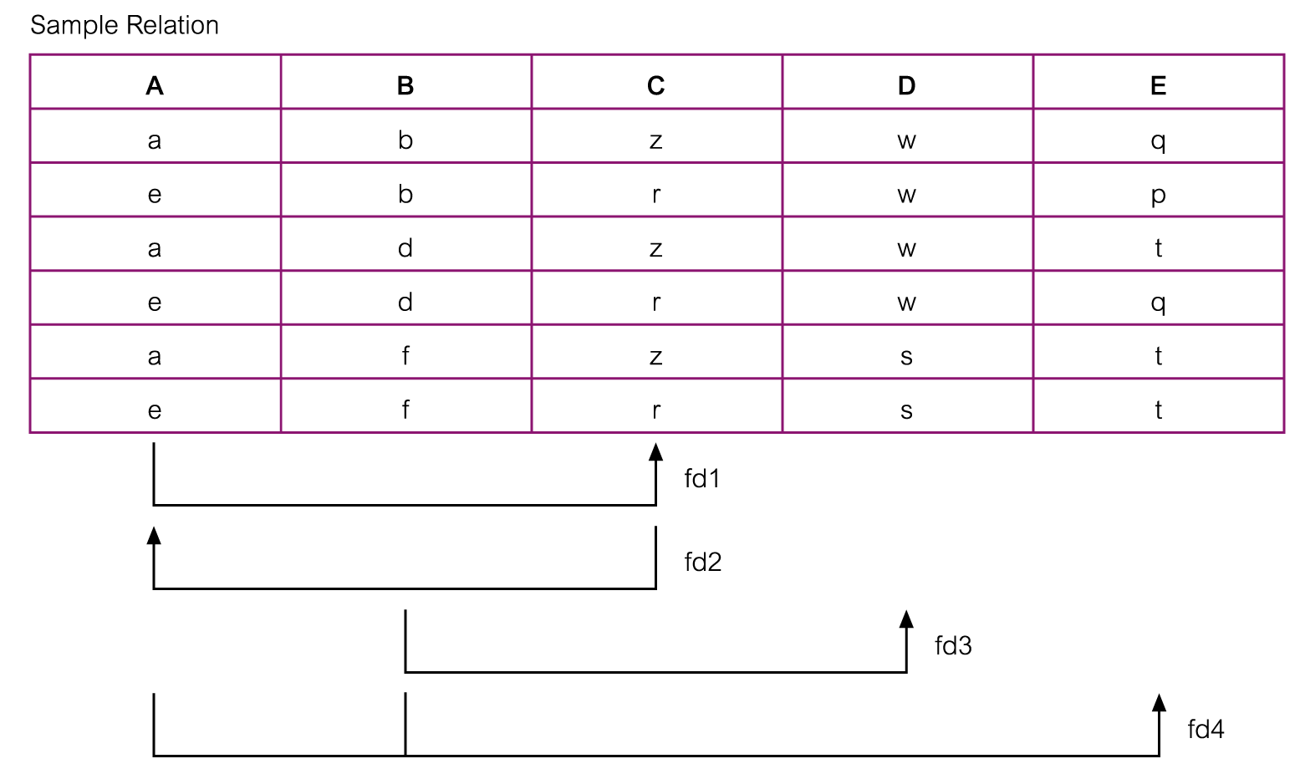
Example - Using sample data to identify functional dependencies.
© Pearson Education Limited 1995, 2005

Slide 33
Example - Using sample data to identify functional dependencies.
Function dependencies between attributes A to E in the Sample relation.
A → C (fd1)
C → A (fd2)
B → D (fd3)
A, B → E (fd4)
© Pearson Education Limited 1995, 2005

Slide 34
Identifying the Primary Key for a Relation using Functional Dependencies
Main purpose of identifying a set of functional dependencies for a relation is to specify the set of integrity constraints that must hold on a relation.
An important integrity constraint to consider first is the identification of candidate keys, one of which is selected to be the primary key for the relation.
© Pearson Education Limited 1995, 2005

Slide 35
Example - Identify Primary Key for StaffBranch Relation
StaffBranch relation has five functional dependencies (see Slide 31).
The determinants are staffNo, branchNo, bAddress, (branchNo, position), and (bAddress, position).
To identify all candidate key(s), identify the attribute (or group of attributes) that uniquely identifies each tuple in this relation.
© Pearson Education Limited 1995, 2005

Slide 36
Example - Identifying Primary Key for StaffBranch Relation
All attributes that are not part of a candidate key should be functionally dependent on the key.
The only candidate key and therefore primary key for StaffBranch relation, is staffNo, as all other attributes of the relation are functionally dependent on staffNo.
© Pearson Education Limited 1995, 2005

Slide 37
Example - Identifying Primary Key for Sample Relation
Sample relation has four functional dependencies (see Slide 31).
The determinants in the Sample relation are A, B, C, and (A, B). However, the only determinant that functionally determines all the other attributes of the relation is (A, B).
(A, B) is identified as the primary key for this relation.
© Pearson Education Limited 1995, 2005

Slide 38
The Process of Normalization
As normalization proceeds, the relations become progressively more restricted (stronger) in format and also less vulnerable to update anomalies.
© Pearson Education Limited 1995, 2005

Slide 39
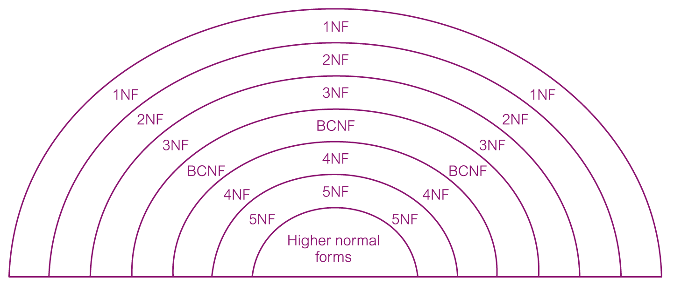
The Process of Normalization
© Pearson Education Limited 1995, 2005

Slide 40
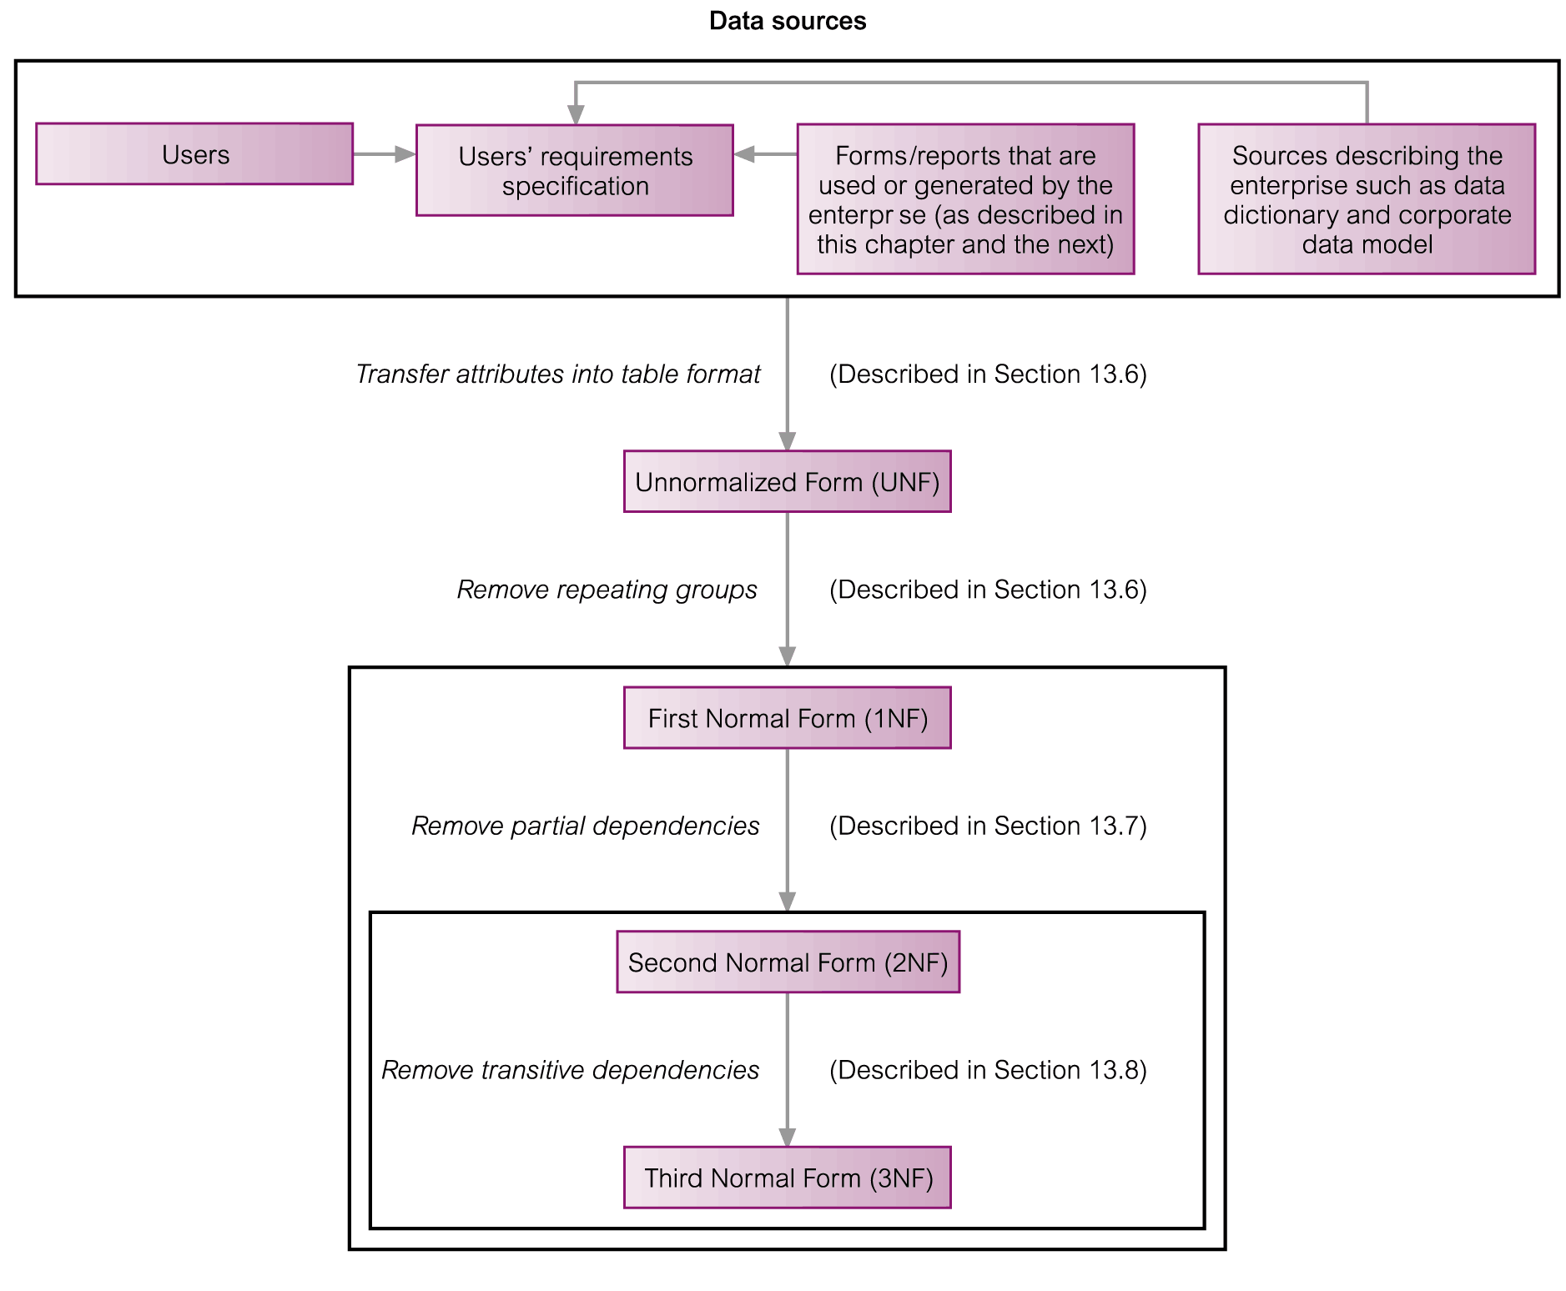
The Process of Normalization
© Pearson Education Limited 1995, 2005

Slide 41
Unnormalized Form (UNF)
A table that contains one or more repeating groups.
To create an unnormalized table
  Transform the data from the information source (e.g. form) into table format with columns and rows.
© Pearson Education Limited 1995, 2005

Slide 42
First Normal Form (1NF)
A relation in which the intersection of each row and column contains one and only one value.
© Pearson Education Limited 1995, 2005

Slide 43
UNF to 1NF
Nominate an attribute or group of attributes to act as the key for the unnormalized table.
Identify the repeating group(s) in the unnormalized table which repeats for the key attribute(s).
© Pearson Education Limited 1995, 2005

Slide 44
UNF to 1NF
Remove the repeating group by
  Entering appropriate data into the empty columns of rows containing the repeating data (‘flattening’ the table).
  Or by
  Placing the repeating data along with a copy of the original key attribute(s) into a separate relation.
© Pearson Education Limited 1995, 2005

Slide 45
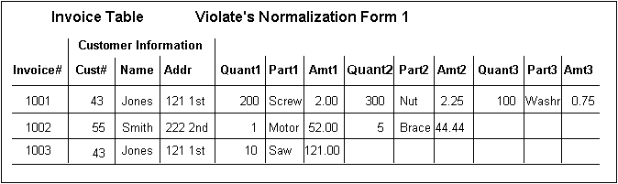
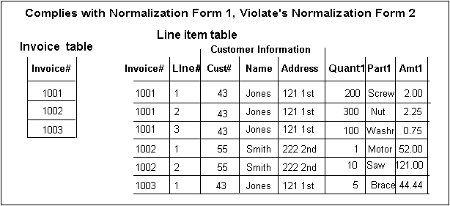

Slide 46
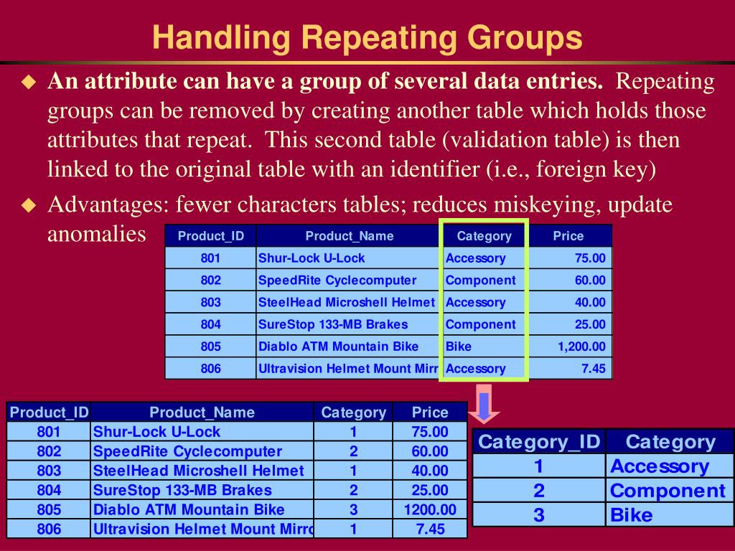

Slide 47
Second Normal Form (2NF)
Based on the concept of full functional dependency.
Full functional dependency indicates that if
  A and B are attributes of a relation,
  B is fully dependent on A if B is functionally dependent on A but not on any proper subset of A.
© Pearson Education Limited 1995, 2005

Slide 48
Second Normal Form (2NF)
A relation that is in 1NF and every non-primary-key attribute is fully functionally dependent on the primary key.
© Pearson Education Limited 1995, 2005

Slide 49
1NF to 2NF
Identify the primary key for the 1NF relation.
Identify the functional dependencies in the relation.
If partial dependencies exist on the primary key remove them by placing then in a new relation along with a copy of their determinant.
© Pearson Education Limited 1995, 2005

Slide 50
Third Normal Form (3NF)
Based on the concept of transitive dependency.
Transitive Dependency is a condition where
  A, B and C are attributes of a relation such that if A → B and B → C,
  then C is transitively dependent on A through B. (Provided that A is not functionally dependent on B or C).
© Pearson Education Limited 1995, 2005

Slide 51
Third Normal Form (3NF)
A relation that is in 1NF and 2NF and in which no non-primary-key attribute is transitively dependent on the primary key.
© Pearson Education Limited 1995, 2005

Slide 52
2NF to 3NF
Identify the primary key in the 2NF relation.
Identify functional dependencies in the relation.
If transitive dependencies exist on the primary key remove them by placing them in a new relation along with a copy of their dominant.
© Pearson Education Limited 1995, 2005

Slide 53
General Definitions of 2NF and 3NF
Second normal form (2NF)
  A relation that is in first normal form and every non-primary-key attribute is fully functionally dependent on any candidate key.
Third normal form (3NF)
  A relation that is in first and second normal form and in which no non-primary-key attribute is transitively dependent on any candidate key.
© Pearson Education Limited 1995, 2005

Slide 54
More on Functional Dependencies
The complete set of functional dependencies for a given relation can be very large.
Important to find an approach that can reduce the set to a manageable size.
© Pearson Education Limited 1995, 2005

Slide 55
Inference Rules for Functional Dependencies
Need to identify a set of functional dependencies (represented as X) for a relation that is smaller than the complete set of functional dependencies (represented as Y) for that relation and has the property that every functional dependency in Y is implied by the functional dependencies in X.
© Pearson Education Limited 1995, 2005

Slide 56
Inference Rules for Functional Dependencies
The set of all functional dependencies that are implied by a given set of functional dependencies X is called the closure of X, written X⁺ .
A set of inference rules, called Armstrong’s axioms, specifies how new functional dependencies can be inferred from given ones.
© Pearson Education Limited 1995, 2005

Slide 57
Inference Rules for Functional Dependencies
Let A, B, and C be subsets of the attributes of the relation R. Armstrong’s axioms are as follows:
(1) Reflexivity
    If B is a subset of A, then A → B
  (2) Augmentation
  If A → B, then A,C → B,C
  (3) Transitivity
  If A → B and B → C, then A → C
© Pearson Education Limited 1995, 2005

Slide 58
Inference Rules for Functional Dependencies
Further rules can be derived from the first three rules that simplify the practical task of computing X+. Let D be another subset of the attributes of relation R, then:
(4) Self-determination
A → A
(5) Decomposition
If A → B,C, then A → B and A → C
© Pearson Education Limited 1995, 2005

Slide 59
Inference Rules for Functional Dependencies
(6) Union
If A → B and A → C, then A → B,C
(7) Composition
If A → B and C → D then A,C → B,D
© Pearson Education Limited 1995, 2005

Slide 60
Minimal Sets of Functional Dependencies
A set of functional dependencies Y is covered by a set of functional dependencies X, if every functional dependency in Y is also in X+; that is, every dependency in Y can be inferred from X.
A set of functional dependencies X is minimal if it satisfies the following conditions:
  Every dependency in X has a single attribute on its right-hand side.
© Pearson Education Limited 1995, 2005

Slide 61
Minimal Sets of Functional Dependencies
  We cannot replace any dependency A → B in X with dependency C → B, where C is a proper subset of A, and still have a set of dependencies that is equivalent to X.
  We cannot remove any dependency from X and still have a set of dependencies that is equivalent to X.
© Pearson Education Limited 1995, 2005

Slide 62
Boyce–Codd Normal Form (BCNF)
Based on functional dependencies that take into account all candidate keys in a relation, however BCNF also has additional constraints compared with the general definition of 3NF.
Boyce–Codd normal form (BCNF)
  A relation is in BCNF if and only if every determinant is a candidate key.
© Pearson Education Limited 1995, 2005

Slide 63
Boyce–Codd Normal Form (BCNF)
Difference between 3NF and BCNF is that for a functional dependency A → B, 3NF allows this dependency in a relation if B is a primary-key attribute and A is not a candidate key. Whereas, BCNF insists that for this dependency to remain in a relation, A must be a candidate key.
Every relation in BCNF is also in 3NF. However, a relation in 3NF is not necessarily in BCNF.
© Pearson Education Limited 1995, 2005

Slide 64
Boyce–Codd Normal Form (BCNF)
Violation of BCNF is quite rare.
The potential to violate BCNF may occur in a relation that:
  contains two (or more) composite candidate keys;
  the candidate keys overlap, that is have at least one attribute in common.
© Pearson Education Limited 1995, 2005

Slide 65
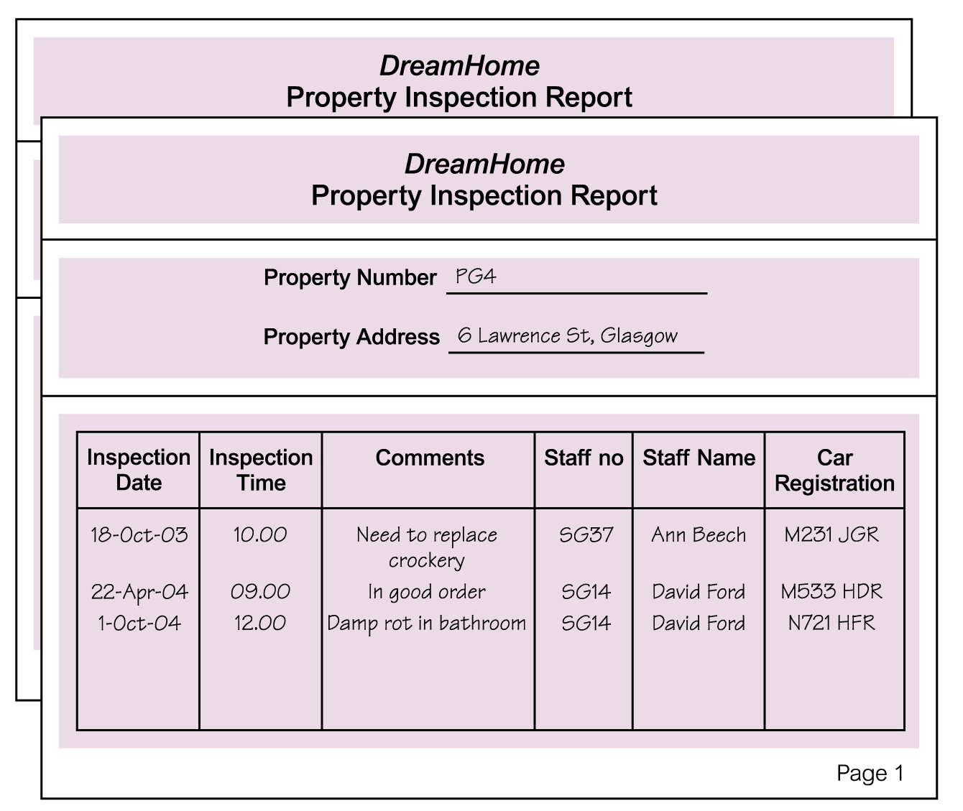
Review of Normalization (UNF to BCNF)
© Pearson Education Limited 1995, 2005

Slide 66
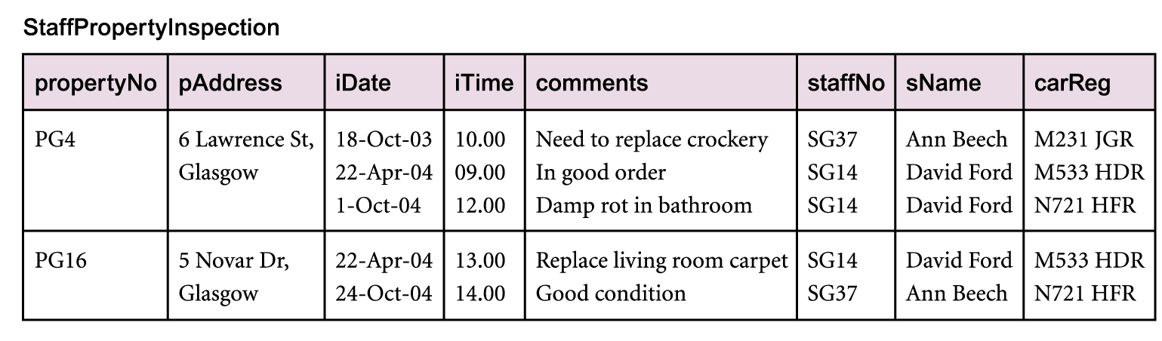
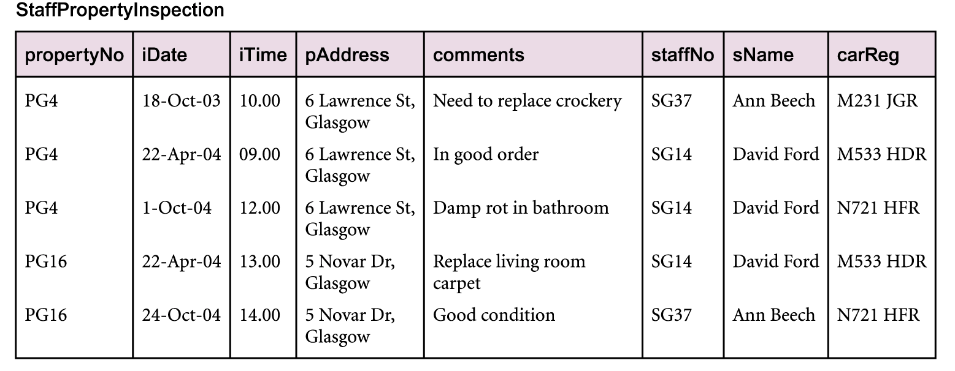
Review of Normalization (UNF to BCNF)
© Pearson Education Limited 1995, 2005

Slide 67
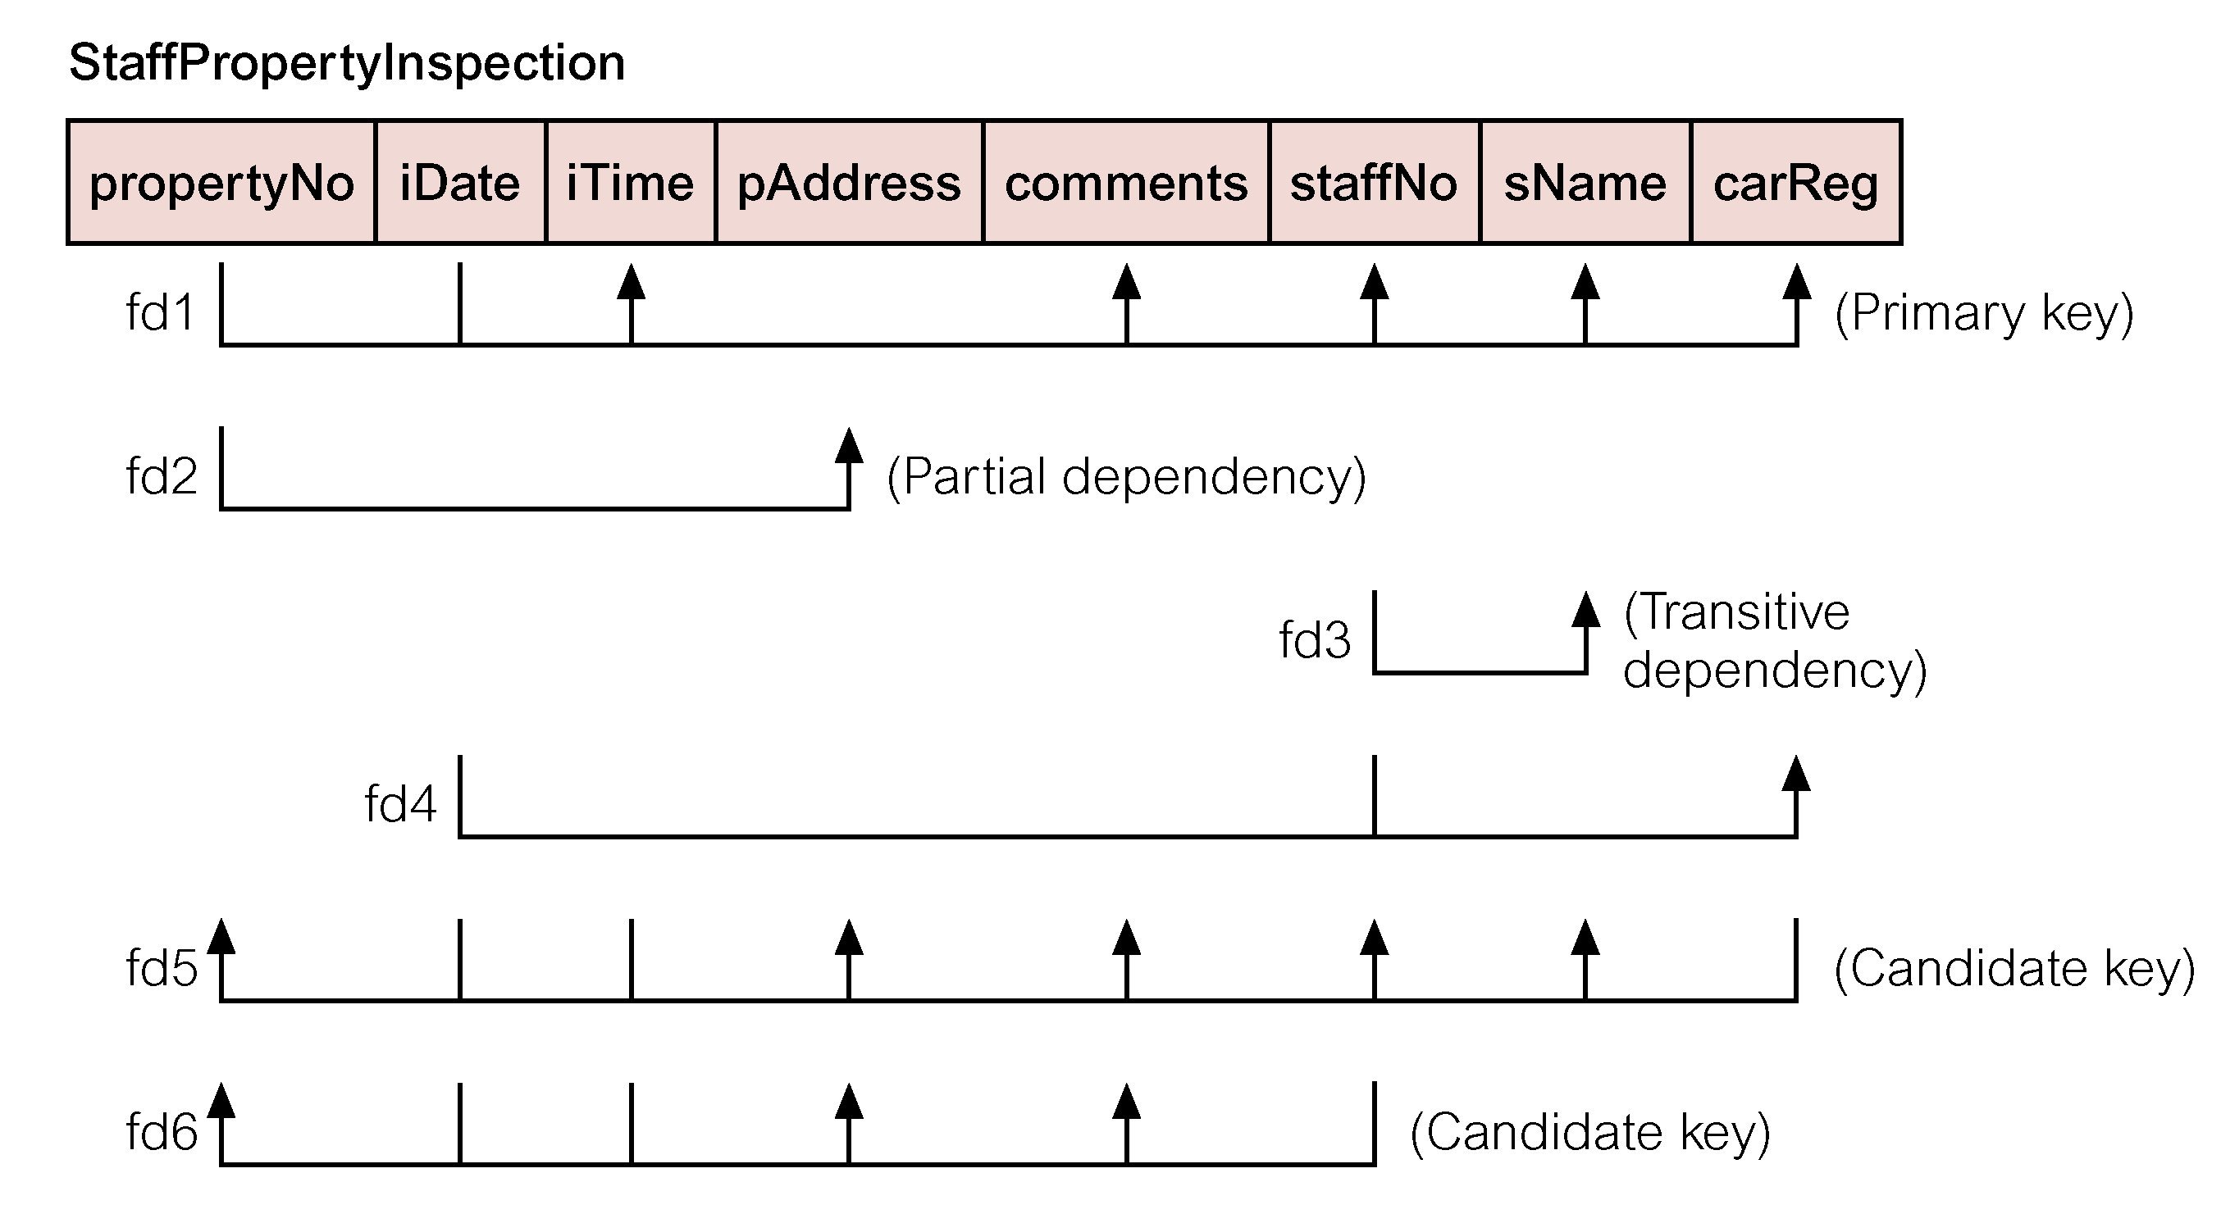
Review of Normalization (UNF to BCNF)
© Pearson Education Limited 1995, 2005

Slide 68
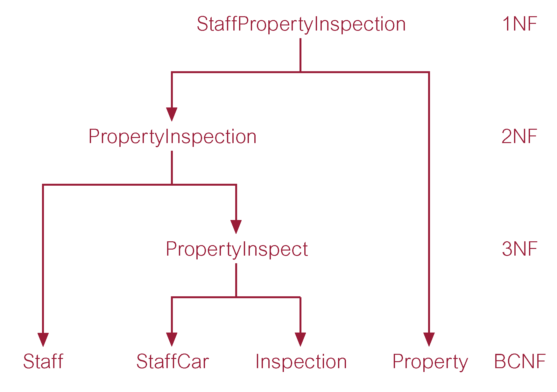
Review of Normalization (UNF to BCNF)
© Pearson Education Limited 1995, 2005

Slide 69
Fourth Normal Form (4NF)
Although BCNF removes anomalies due to functional dependencies, another type of dependency called a multi-valued dependency (MVD) can also cause data redundancy.
Possible existence of multi-valued dependencies in a relation is due to 1NF and can result in data redundancy.
© Pearson Education Limited 1995, 2005

Slide 70
Fourth Normal Form (4NF)
Multi-valued Dependency (MVD)
  Dependency between attributes (for example, A, B, and C) in a relation, such that for each value of A there is a set of values for B and a set of values for C. However, the set of values for B and C are independent of each other.
© Pearson Education Limited 1995, 2005

Slide 71
Fourth Normal Form (4NF)
MVD between attributes A, B, and C in a relation using the following notation:
A −>> B
A −>> C
© Pearson Education Limited 1995, 2005

Slide 72
Fourth Normal Form (4NF)
A multi-valued dependency can be further defined as being trivial or nontrivial.
  A MVD A −>> B in relation R is defined as being trivial if (a) B is a subset of A or (b) A ∪ B = R.
  A MVD is defined as being nontrivial if neither (a) nor (b) are satisfied.
  A trivial MVD does not specify a constraint on a relation, while a nontrivial MVD does specify a constraint.
© Pearson Education Limited 1995, 2005

Slide 73
Fourth Normal Form (4NF)
Defined as a relation that is in Boyce-Codd Normal Form and contains no nontrivial multi-valued dependencies.
© Pearson Education Limited 1995, 2005

Slide 74
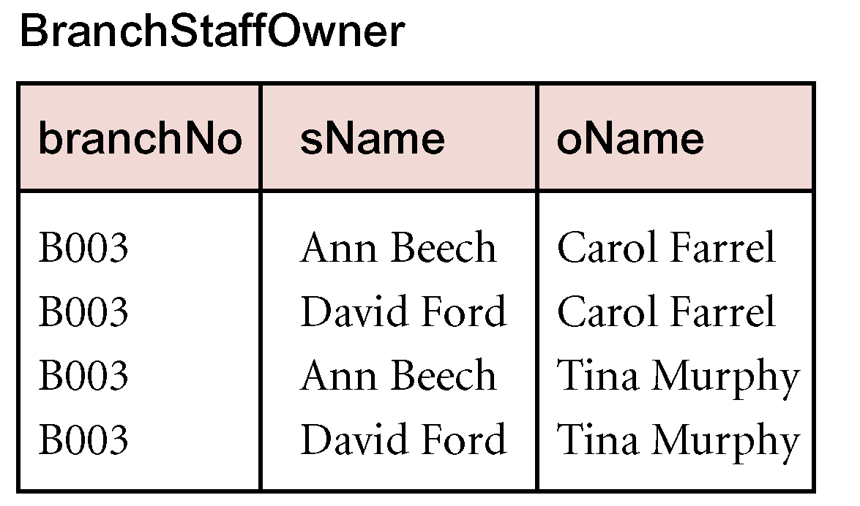
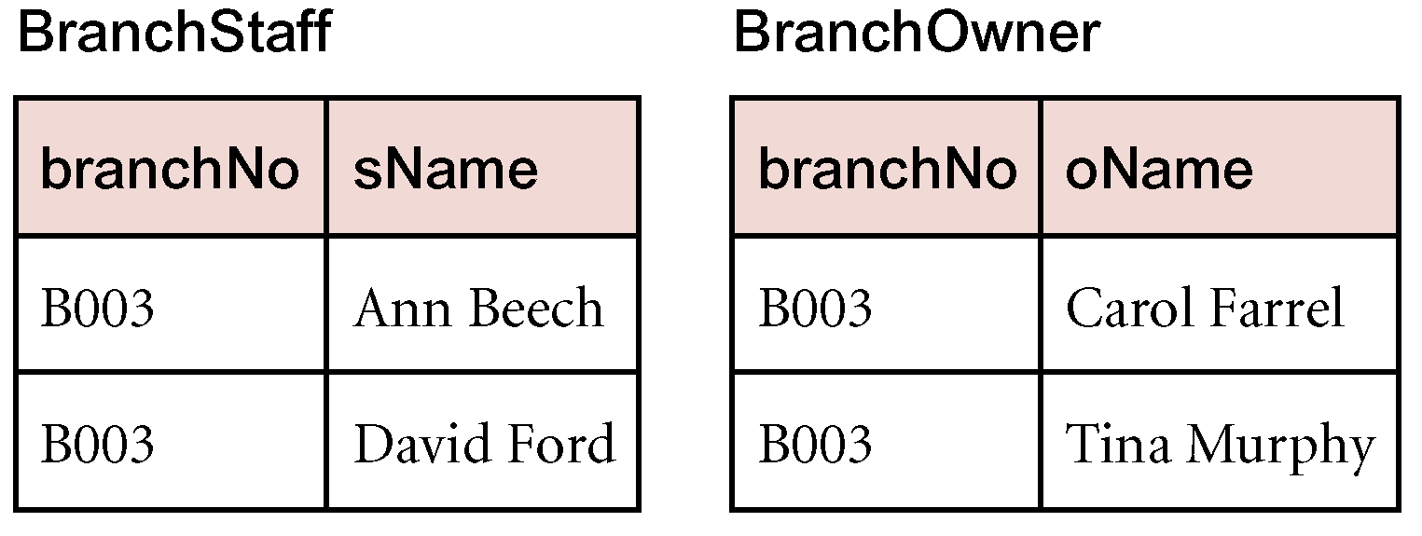
4NF - Example
© Pearson Education Limited 1995, 2005

